Slide 1
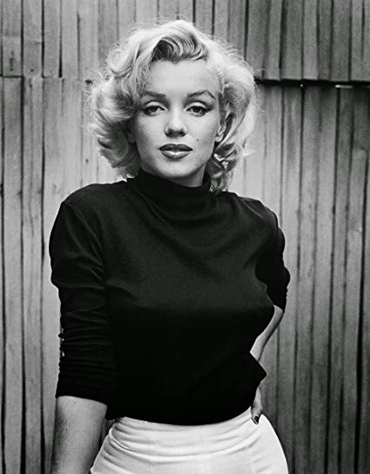
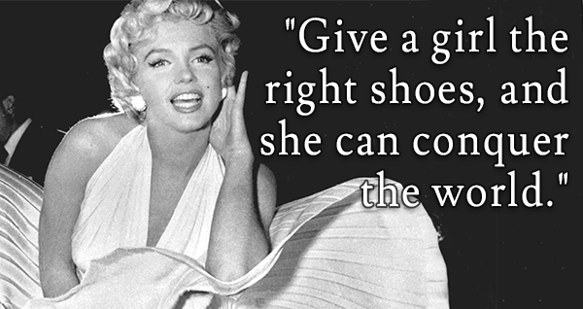

Marilyn monroe
By Robin Oosterhof

Slide 2
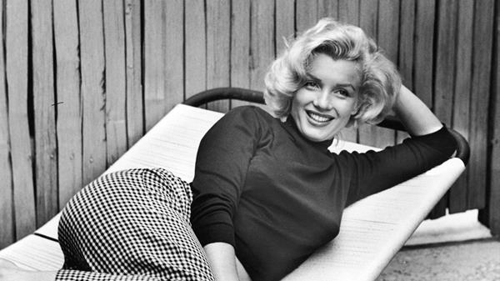
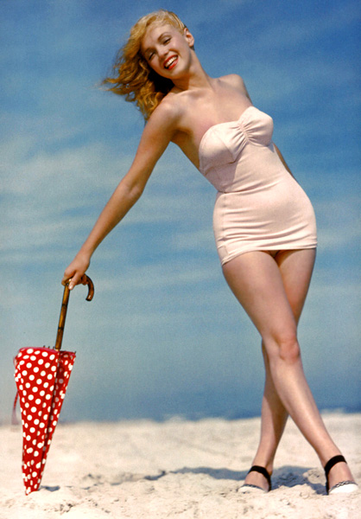
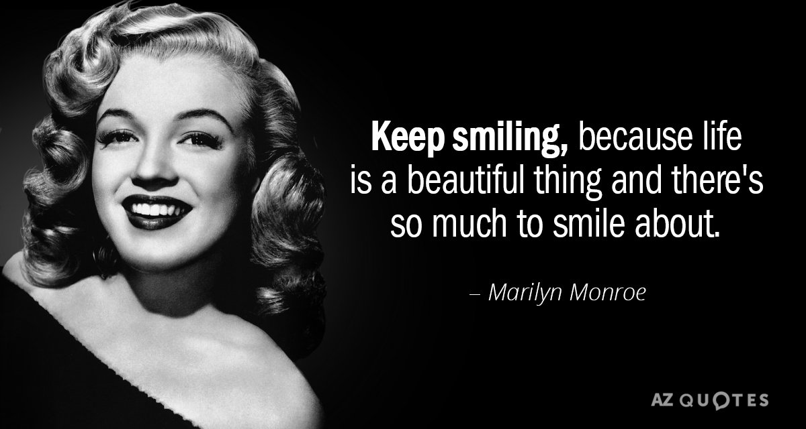
Who is Marilyn Monroe?
Model
Sex icon
Moviestar
Her own style
Inspiring quotes
Inspiring woman overall

Slide 3
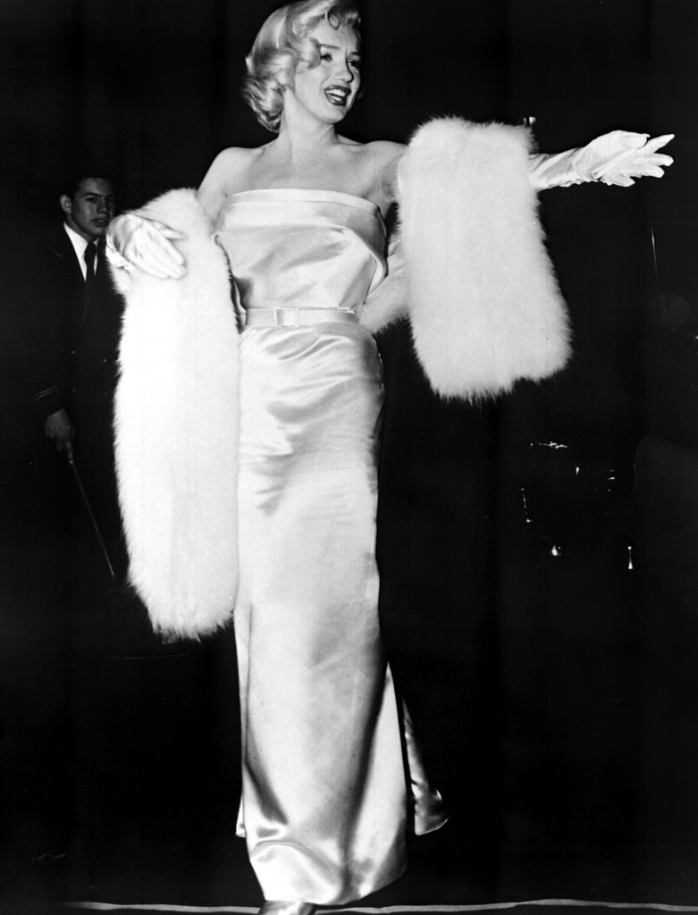
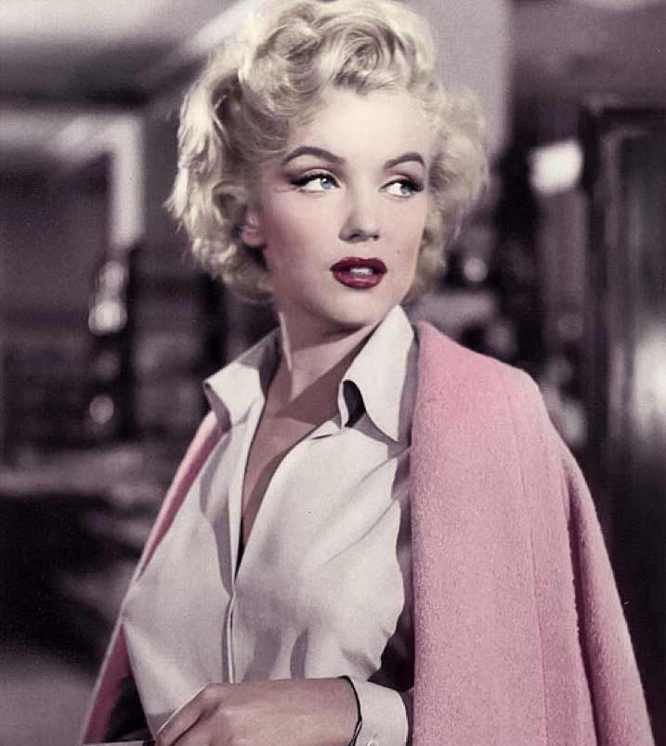
Before the research
Marilyn Monroe as a person
Sex icon
Movie star
Style

Slide 4
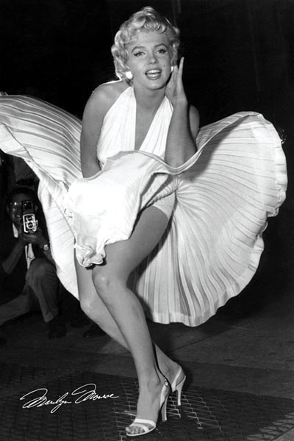
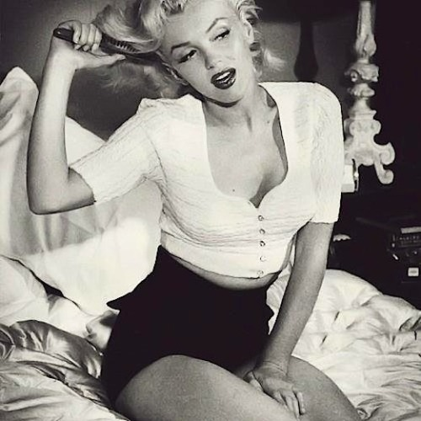
The research
Childhood
How did she become an actress?
How did she become a sex icon?
Why is she so inspiring?
The materials I researched

Slide 5
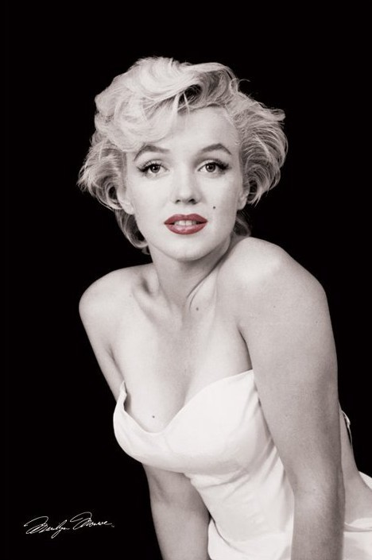
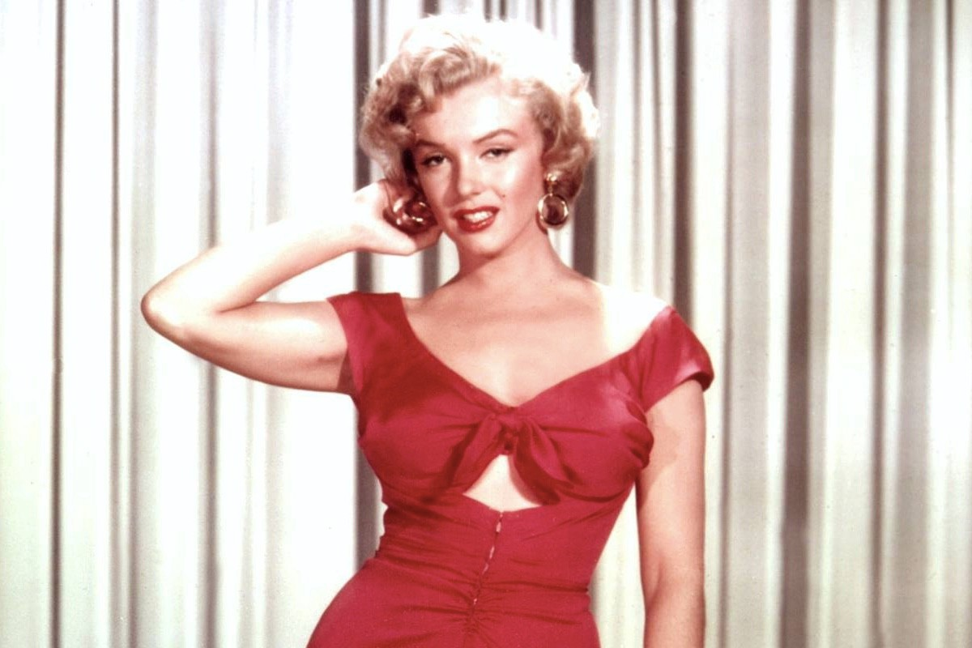
After the research
Different view on her
More inspiring
I found out the things I wanted to know about her

Slide 6
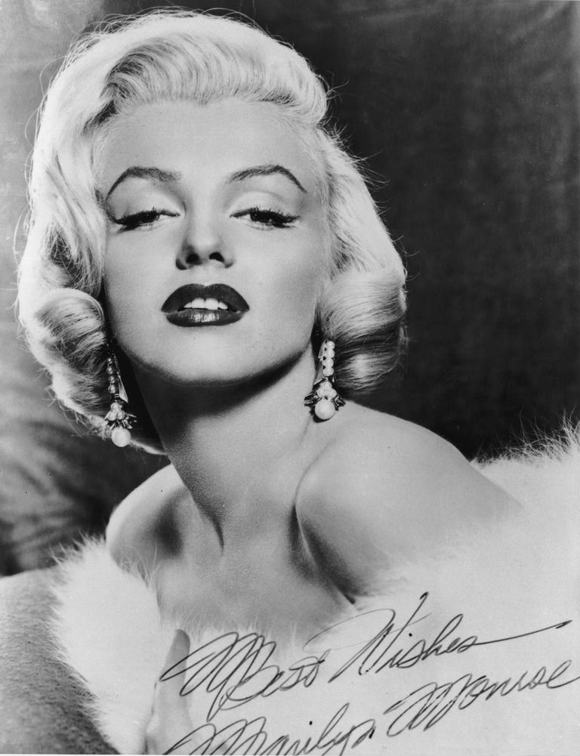
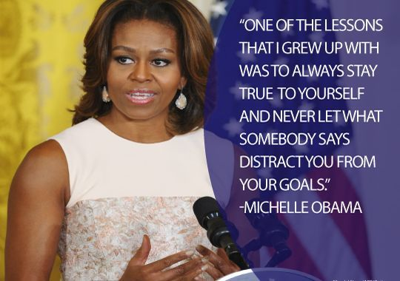

In the classroom
All inspiring women
Different types of exercizes
General knowledge

